Slide 1
Flipkart
Sales Performance:
Key Metrics & Trends
Analysis and insights into the sales performance of e-commerce platform Flipkart. The analysis and insight presented have been drawn from a Flipkart Retail Product dataset, which covers products, pricing, ratings and sellers from 2018-2023.

Slide 2
OBJECTIVE : The objective of this presentation is to understand the drop in sales by providing a clear insight into the sales performance of Flipkart from 2018 through to 2023.
By the end of this session, we will be to identify the reason for a drop in sales and recommend actions that can be taken to improve them.
Key Questions being answered:
What were the final sales for each year, before and after the discounts were applied?
Where do we see the drop in sales?
How does the average customer review change from 2018-2023, and does it correlate with the drop in sales? If so, how does it correlate?
What recommendations could be made to improve the performance in sales ?

Slide 3
Sales Performance 2018-2023
Flipkart faced a fluctuation in sales from 2018 to 2023, with their yearly sales increasing and decreasing each year. Overall, they ended with a 48.5% drop in sales from 2018 to 2023. Their biggest loss being from 2022 to 2023.
They also faced a significant drop in units sold from 2018 to 2023, with units sold increasing and decreasing at the same rate with the sales performance for each year
However, Flipkart did save a significant amount of money from a drop in discounts from 2018 to 2023.

Slide 4
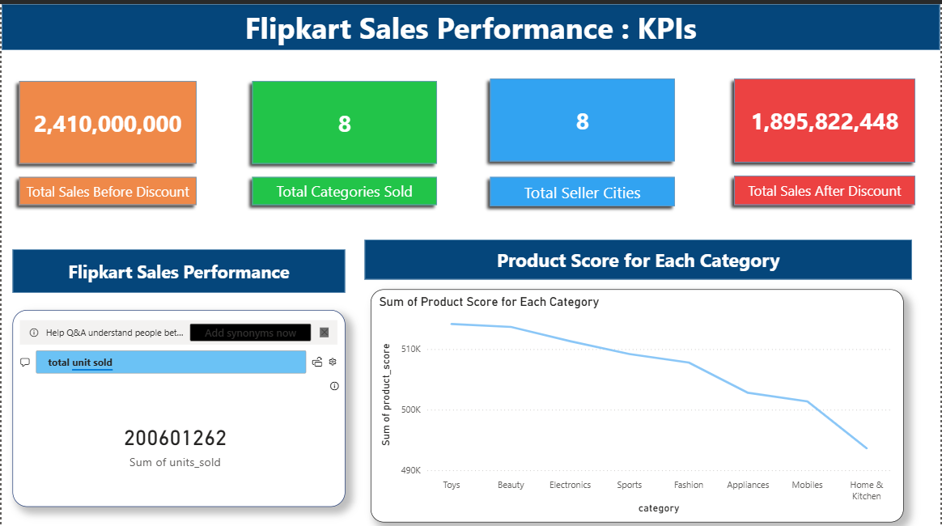

Slide 5
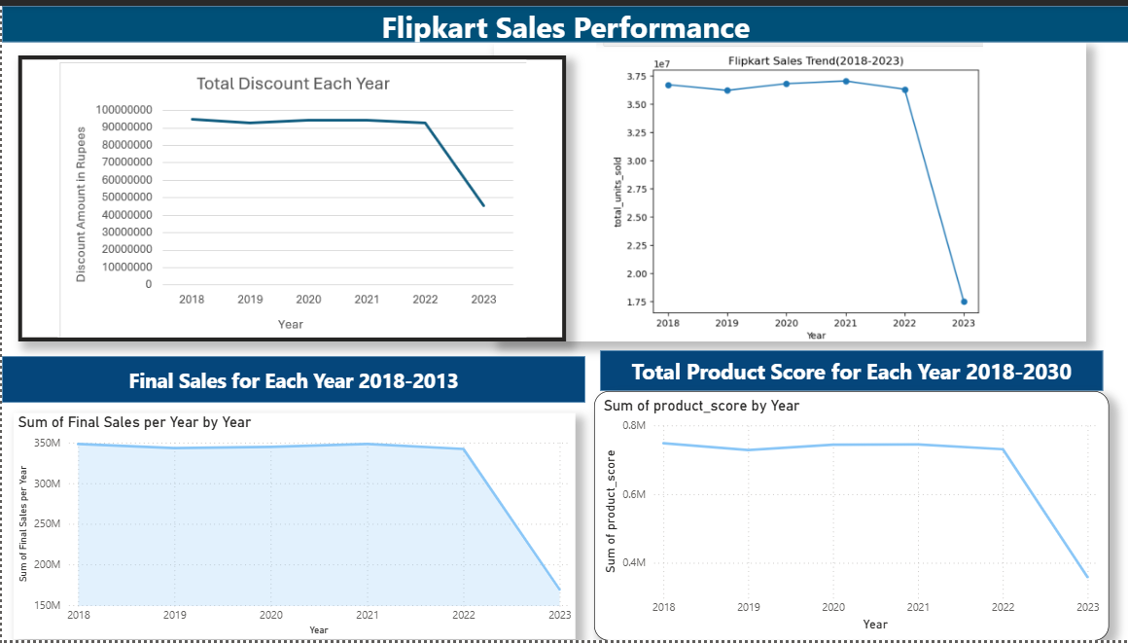

Slide 6
Sales performance weak due to impact of low volume availability, promotions and reviews
Dashboard analysis shows that Flipkart’s sales declined significantly in 2023 following steady performance from 2018 to 2022.
As well as a drop in sales, there has also been a drop in units sold and the scoring of products from consumers.
However, Flipkart offered less discounts over the years. From 2018 to 2023, they had a 48% drop in money lost in discounts, which meant that the company should have seen more in profits.

Slide 7
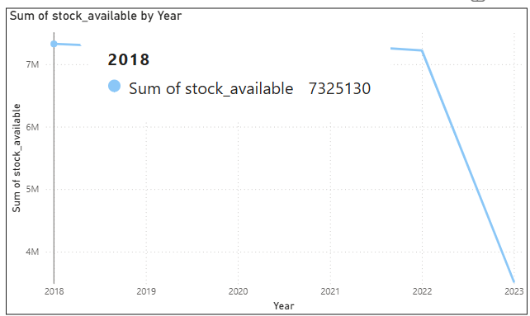
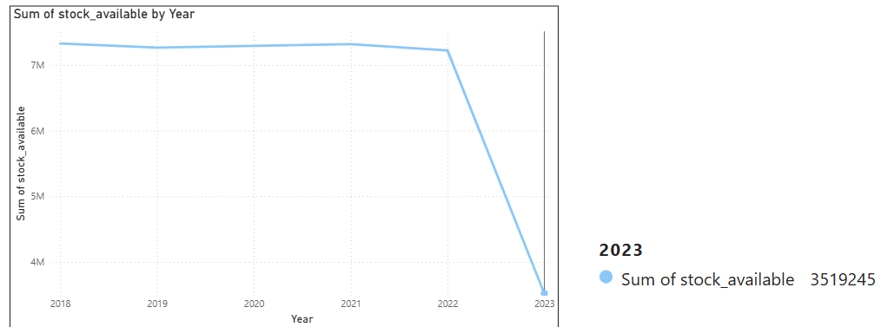
Available stock also took a significant dip from 2022 to 2023. Less than 50% of stock from 2018 was available in 2023
This may have contributed to the low sales performance in 2023, as well as other contributing factors.

Slide 8
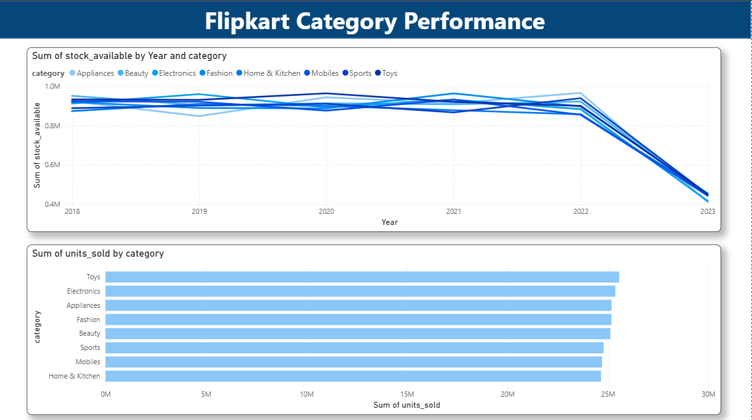

Slide 9
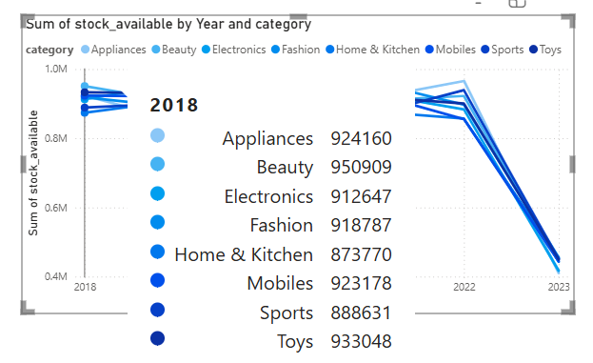
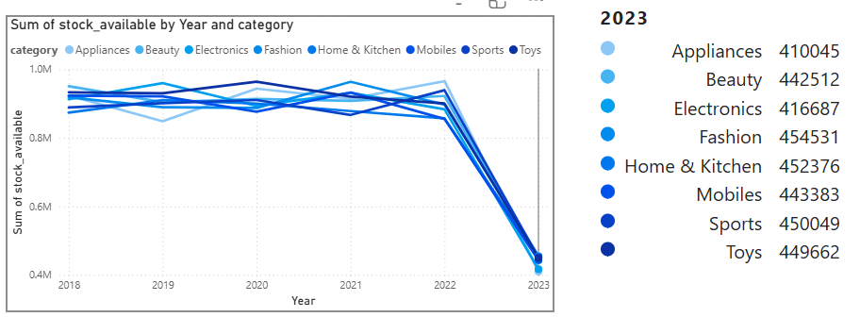
Data shows a fluctuation in popular sold stock from 2018 to 2023, but there is also a significant drop in stock available. This may also have contributed to the drop in sales and declining overall sales performance.

Slide 10
From Insights to Impact
Deploy Discounts More Consistently across Eligible Deals
Data shows that consistent discounts across products leads to higher sales for Flipkart.
For example, in 2018 the company made 348 million and handed out 95 millions worth in discounts. In 2018, the company made 169 million but only gave out 45.7 million in discounts.
Flipkart should consider deploying more discounts, as it brings in more sales for the company. Flipkart does lose a significant amount in discounts but makes up for it in sales, So it’s a big risk but with a much bigger reward.
Strategically Increase Inventory Coverage In Demand-Constrained SKUs
Flipkart faced a significant drop in stock available from 2022 to 2023. From 2018 to 2022, the amount of stock available fluctuated but remained steady until 2023.
Graphs show that the drop in available stock correlates with drop in profits and overall sales performance of the company. Which points to lack of stock as a cause for the decline in sales.
Increasing the quantity of stock available, especially amongst popular stock and stock with high discount, would increase sales within the company and may improve the performance of the company.

